Slide 1
Teaching with Heart
Yolanda Sanchez, MIGRANT, TCDD

Slide 2
Notes:
Icebreakers Volume 5: All-About-You Activities for the First Days of School
Fresh start
Want some information on classroom management.
I. Brochure:
Introduce yourself to the students
Tell them about your hopes for the new school year and some of the fun things you’ll be doing in class/sylabus

Slide 3
How heart Is Key to Art: Appraisal in Texas
All language taken from the Distinguished column of Draft Rubric Version 2
Planning—Dimension 1.4
Students take ownership of group and individual accountability
Students set goals, reflect on, evaluate and hold each other accountable within instructional groups
Instruction—Dimension 2.1
Students establish high academic and social-emotional expectations for themselves.
Opportunities for students to self-monitor and self-correct mistakes.
Students set goals for themselves and monitor their progress over time.

Slide 4
How heart Is Key to Art: Appraisal in Texas
Instruction—Dimension 2.3
Teacher inspires student-led learning
Use of student misunderstandings to highlight misconceptions
Balances student resources
Establishes classroom practices that encourage all students to safely communicate using visual tools and technology with the teacher and their peers.

Slide 5
How heart Is Key to Art: Appraisal in Texas
Classroom Environment, Routines and Procedures—Dimension 3.1
Teacher establishes effective routines, transactions, and procedures that primarily rely on student leadership and responsibility.
Students take primary leadership and responsibility for managing student groups, supplies, and/or equipment.
The classroom is safe and thoughtfully designed to engage, challenge, and inspire students to participate in high-level learning beyond the learning objectives.

Slide 6
How heart Is Key to Art: Appraisal in Texas
Managing Student Behavior—Dimension 3.2
Teacher consistently monitors behavior subtly, reinforces positive behaviors appropriately, and intercepts misbehavior fluidly.
Students and the teacher create, adopt, and maintain classroom behavior standards.
Classroom Culture—Dimension 3.3
Teacher consistently engages all students with relevant, meaningful learning based on their interests, abilities to create a positive rapport amongst students.
Students collaborate positively and encourage each other’s efforts and achievements.

Slide 7
Heart IS The key TO MOVING Teachers and Students
Along the spectrum of Professional Behavior

Slide 8
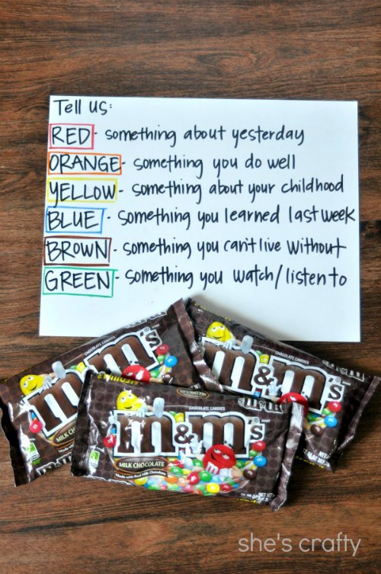
Notes:
This is the M and M game.
I bought a few bags of M and M's and poured them into a bowl. Then each girl scooped a cupful. When it was her turn, she reached into her cup and grabbed an M and M. She then answered a question based on whichever color she grabbed. It was really fun too and the girls enjoyed snacking on the treats as we played.

Slide 9
Notes:
I wrote down a bunch of questions on pieces of paper. The person who was "it" picked a question then wrote their answer down on the dry erase board, without showing anyone. Then she read the question to the group and we had to guess what her answer was.

Slide 10
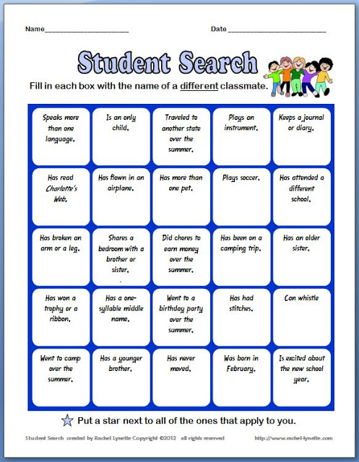
Notes:
Bookmark Greeting: Get to Know Your Readers
I teach 3rd grade and before the students come the first day of school, I send a letter to their home with a special bookmark enclosed. I introduce myself and put some of the things I like to do outside of school. One thing, of course is reading! I invite my students (and I do the same) to bring in a book the first week of school; I ask them to mark their favorite part. It can be any book — one they are reading now or one that has always been a favorite. They mark the part they enjoy with their bookmark and we take turns telling about the book and why we like it. The students LOVE this. We even make a list on chart paper of books we recommend to refer back to throughout the year. I get to know my new students as readers, they get excited about reading first thing, and they find out that their new classmates enjoy the same kinds of books they do! --Susan Heath, Grade 3, Shepard Elementary,
"What's In a Name?": Get to Know Students and Parents
This get-to-know-you activity is called "What's In a Name?" It is a fun and easy way for kids to learn each other's names and a little bit about each other. Just give each student a "What's In a Name?" form at the beginning of the year. The form is simple — just a few questions for them to answer OR ask their parents/guardians to help them answer. Without fail, parents enjoy this beginning-of-the-year task. They often write lengthy responses about how special their child's name is to them. I've found it is a great way to get to know the parents as well! Here are the questions for "What's In a Name?":
What's your full name?
Were you named after someone?
What does your name mean?
What names did your parents consider before deciding on the one you have?
Why did they choose your name?
What is your name's country of origin? (ex. "Ivan" has Russian origins)
What is your nickname? How did you get that nickname?
If you could change your name, what would you name yourself?
Now.... on the bottom of this paper, please write your name in a creative way. Can you use color? Fancy writing? Swirls? Block letters? A pattern? Design something as special as YOU are!
If possible, please attach a small picture of yourself to this form. (photo will be returned.)
The kids bring back their forms, and everyone gets to share about their name in a Community Circle. I usually have kids tell us their name and then they can choose up to two other pieces of information from their form to share with the class. If a child is shy or nervous, I always allow them to simply share their name without the pressure of sharing the additional information. For some kids, it is stressful enough just to speak their name in front of a new class. It's fun to post their "What's In a Name?" papers on a bulletin board in the classroom or hall. That way, lots of people in the school can get to know them, too! I'm sure you'll find — there's a lot in a name! Enjoy this AWESOME activity! --Tressa Decker, grades 1-6, Concord West Elementary, Elkhart, IN

Slide 11
Agree on classroom rules
An ounce of prevention

Slide 12
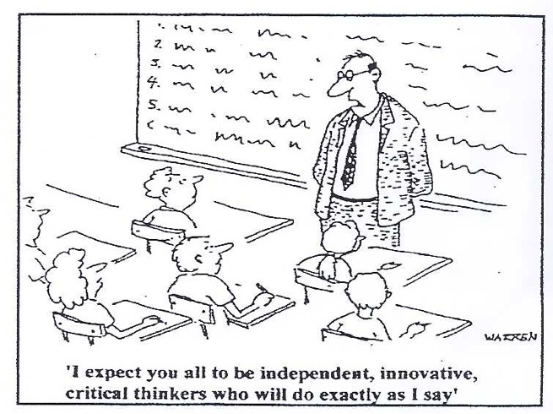

Slide 13
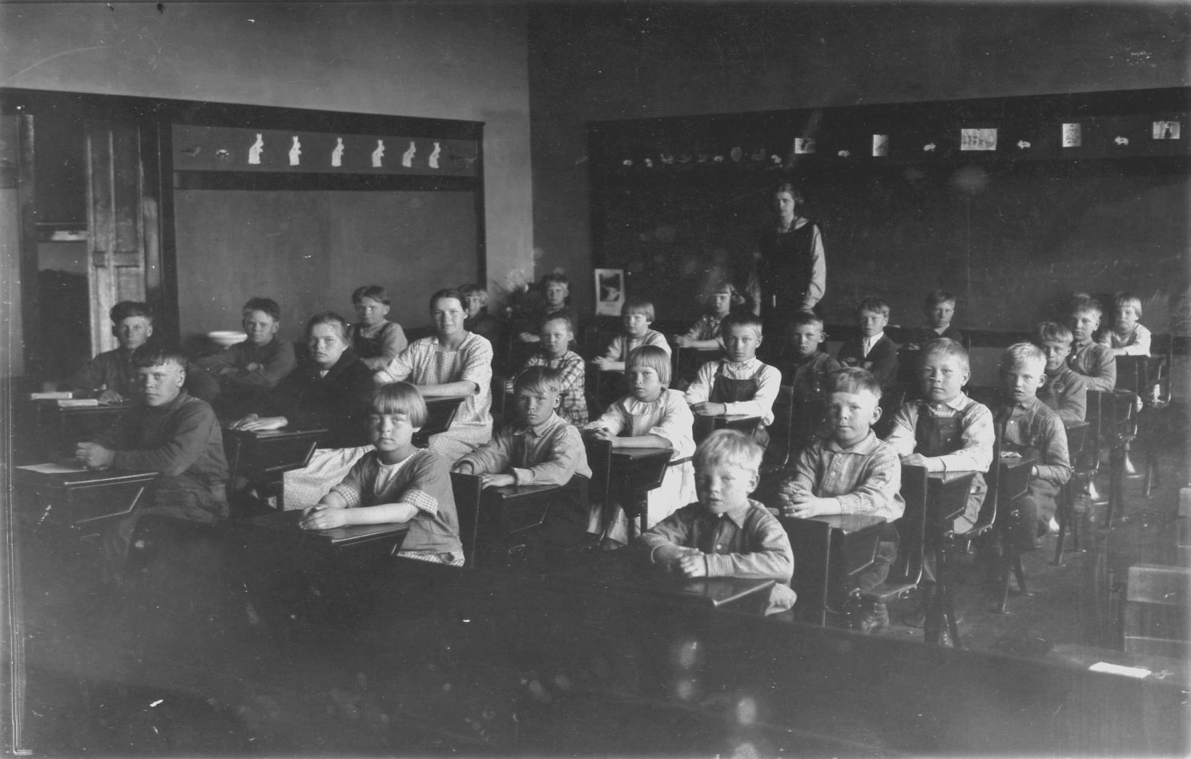

Slide 14
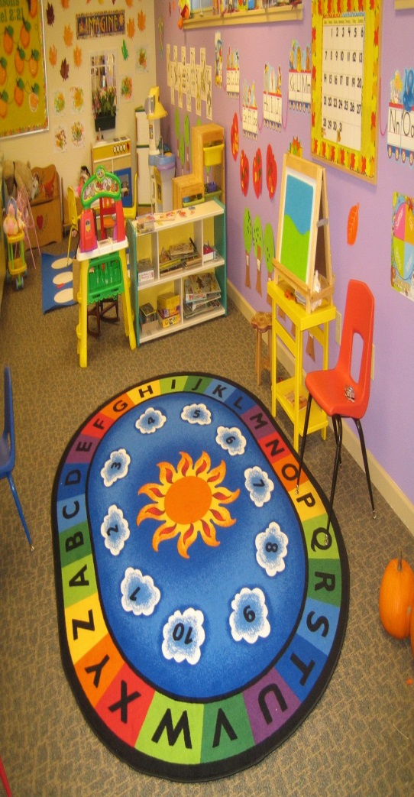
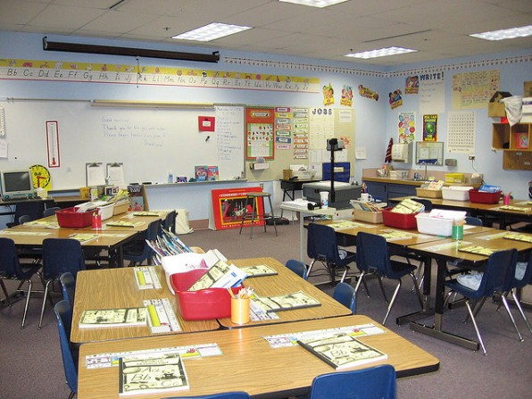
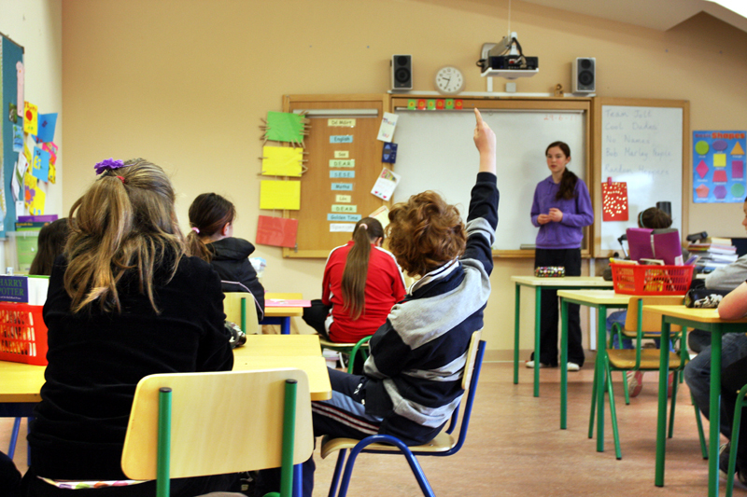

Slide 15
Agree on Classroom Rules
Time taken can prevent misery later
Classroom rules, standards, contract—no matter the name, the goal should be a positive climate

Slide 16
Check in with Students
Catch issues at the door

Slide 17
Check in with Students
Content-based or trivial
Sets the tone
Catches issues at the door before they interrupt learning

Slide 18
Consistent About Expectations
All’s Fair

Slide 19
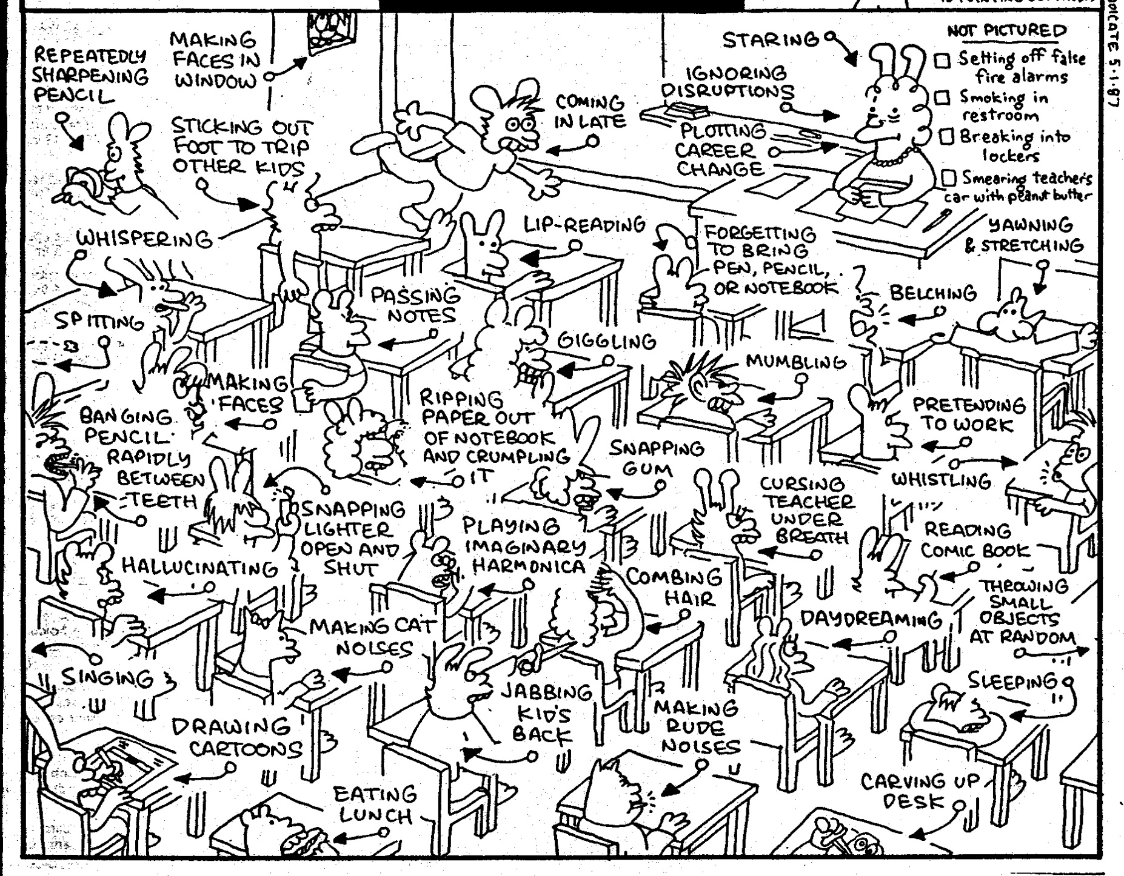

Slide 20
Be Consistent About Expectations
Kid to kid, classroom to classroom
Certainty for kids in uncertain times

Slide 21
Reinforce Appropriate Behavior
I like it, I Love it

Slide 22
Reinforce Appropriate Behavior
Create and support calm students
Similar to preteaching for success rather than waiting to reteach

Slide 23
Maintain Student Dignity
Do So Quietly

Slide 24
Maintain Student Dignity
Corrections are handled quietly and calmly
Reduces fear and leads to higher expectations for discipline

Slide 25
Be Neutral, Not Accusatory
Be Switzerland

Slide 26
Be Neutral, No Accusatory
Questions to ask:
How do you think that made Sally feel?
What are you doing?
What are you supposed to be doing?

Slide 27
Look for the Cause
Like Having Patients—Diagnose

Slide 28
Look for the Cause
Digging for clues benefits you and the student
I know my students.
Student feels valued and known.

